Slide 1
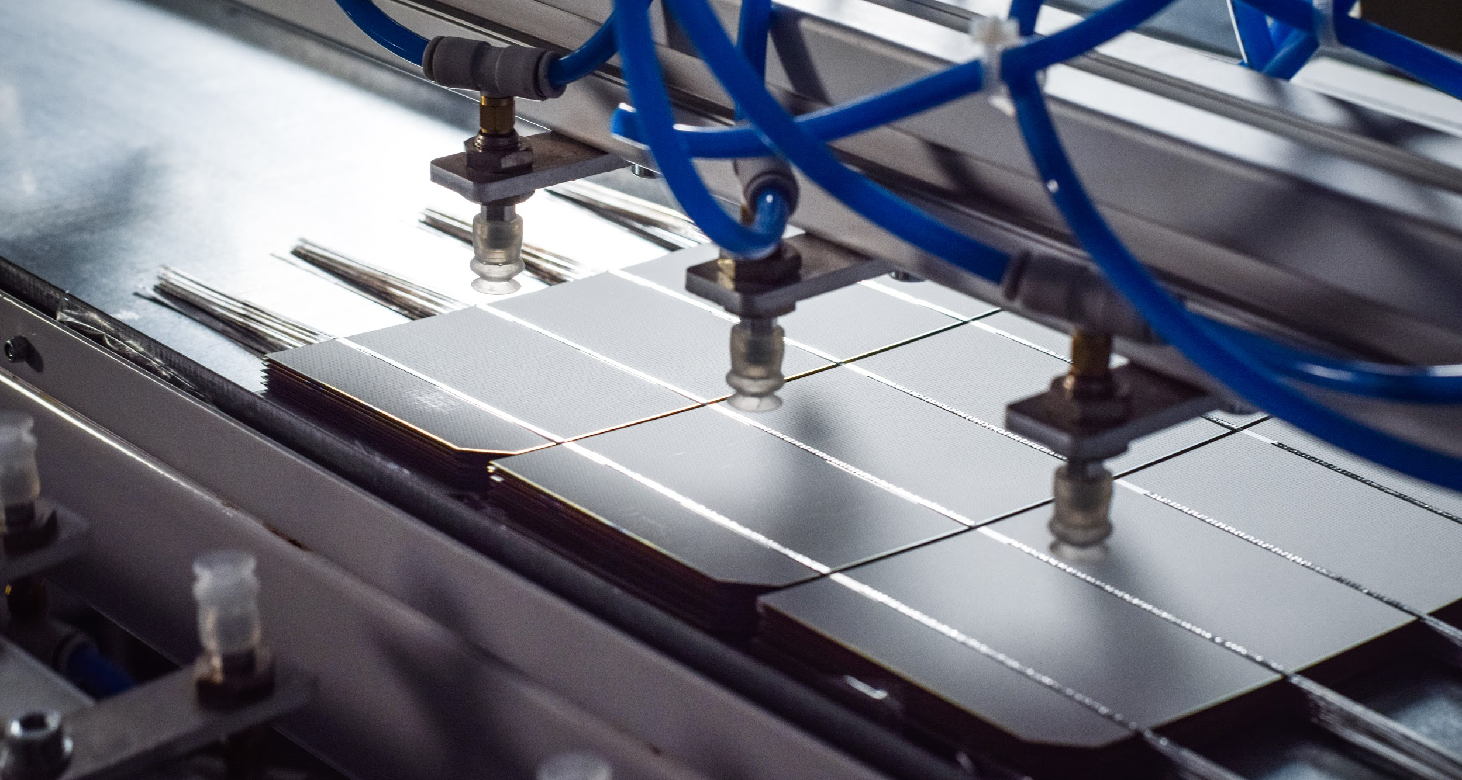
Modern E-Technologies

Slide 2
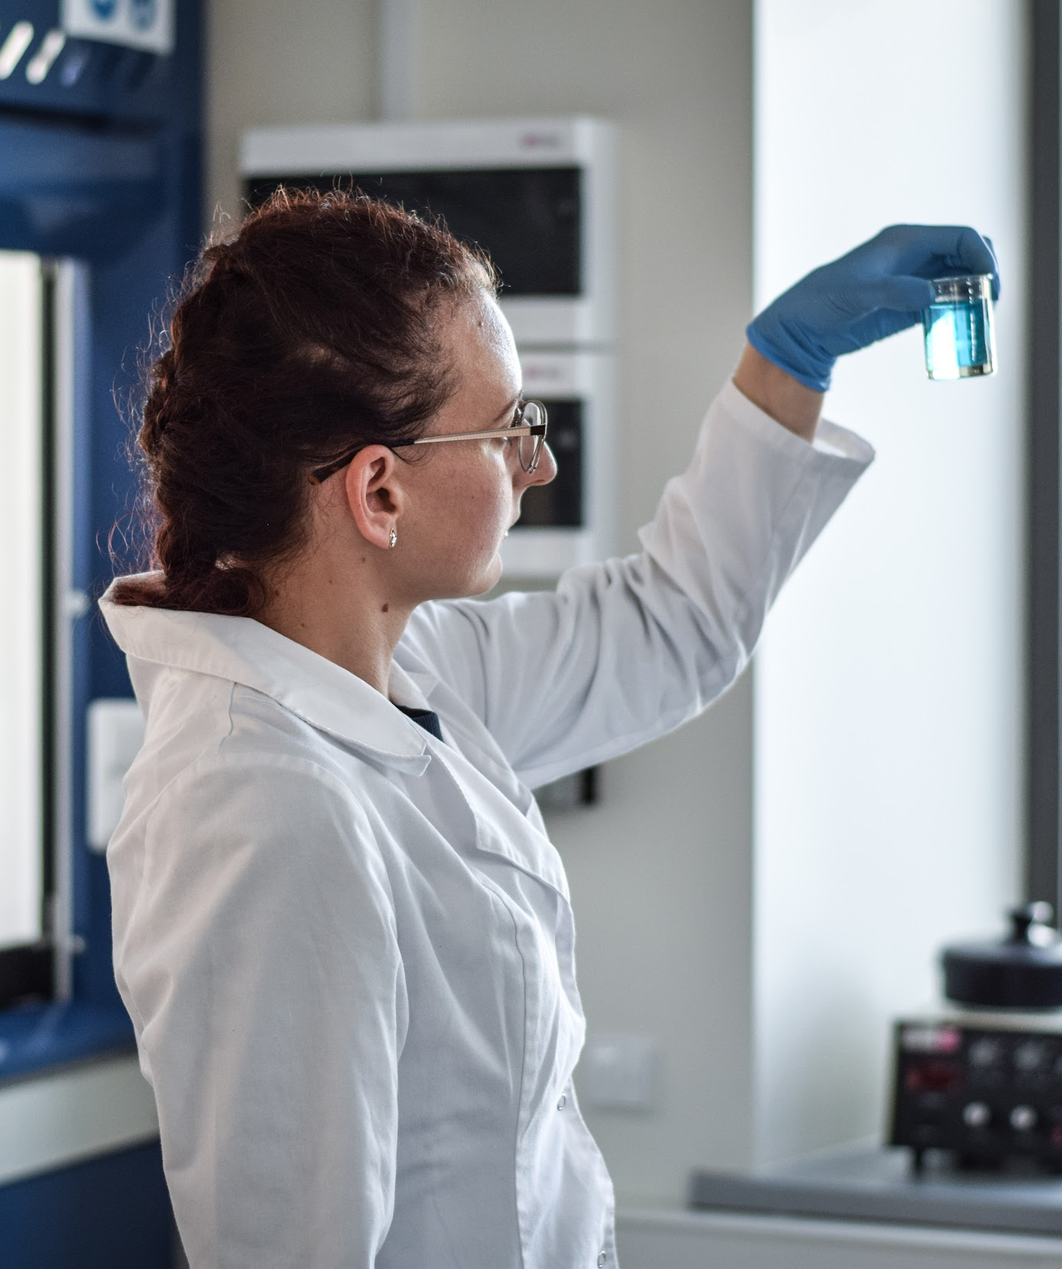
About us
2007
40+
ABOUT MODERN E-TECHNOLOGIES
About Modern E-Technologies
Modern E-Technologies (MET) is a technology intensive company with an aim to produce novel technologies, components and equipment for the renewable energy, thermal & electrical storage, electronics and other technological innovation adoptive industries. From the beginning in 2007 MET is focusing its activities onto knowledge intensive technologies development and commercialization mostly for renewable energy sector.
Founded in
Team members

Slide 3
MODERN E-TECHNOLOGIES GROUP DEPARTMENTS
Modern E-Technologies departments
Met R&D
Met Energy
Met Electronics
Met Manufacturing
Met Testing

Slide 4
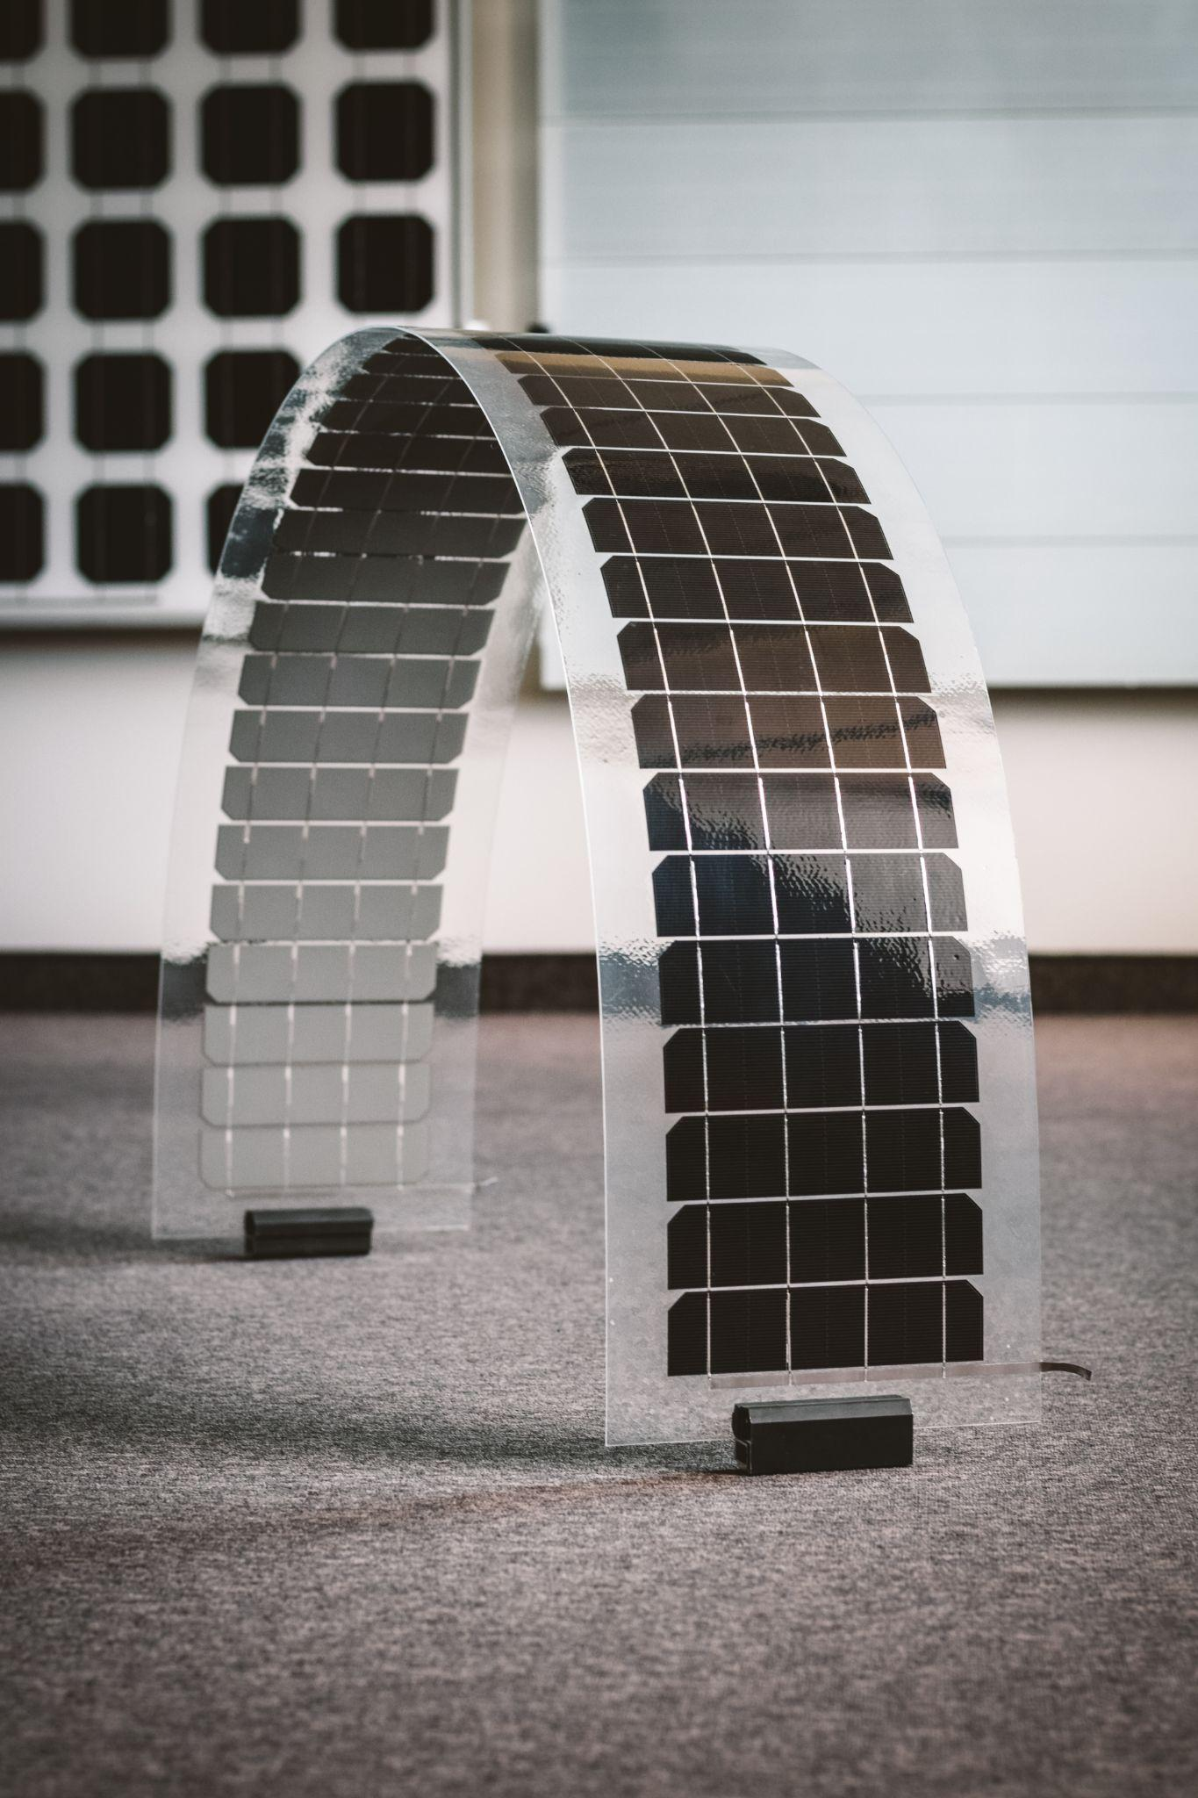
About Met R&D
MODERN E-TECHNOLOGIES
MET R&D is focusing its activities onto knowledge intensive and close to market technologies, material and product development and commercialization for renewable energy sector. The main goal of this department is to provide novelties for solar and thermal energy sectors.
MET R&D is an active participant of international funding programmes (Horizon, Eureka, etc.), therefore participates and manages plenty of regional and international projects (SuperPV, SmartFLEX, SusPire, Coral cells, AidaSUN, etc.)
Areas of activity:
Novel materials
Renewable energy generation and storage
Energy efficiency solutions
Module level power electronics

Slide 5
Call of interest for Modern E-technologies
MODERN E-TECHNOLOGIES
HORIZON-CL5-2024-D2-01-02
Non-Li Sustainable Batteries with European Supply Chains for Stationary Storage (Batt4EU Partnership)

Slide 6
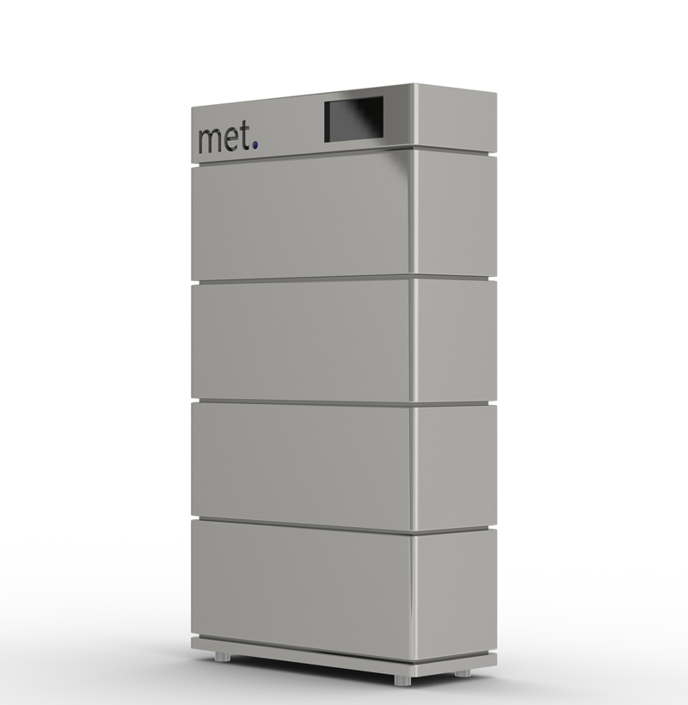
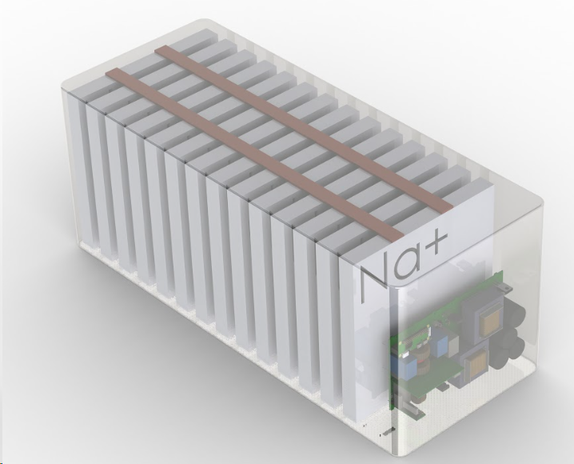
Areas of potential contribution from Modern E-technologies:
MODERN E-TECHNOLOGIES
MET is developing a modular SIB based BESS for residential applications, therefore the primary interest of the company would be to collaborate on developing this type of technology.
Areas of contribution:
Prototype BESS design & assembly;
Prototype validation/testing (demonstration) in operational environment;
BMS & EMS integration into BESS;
Collaboration with University of Technology Sydney (UTS), Australia - as encouraged by the call text.

Slide 7
MODERN E-TECHNOLOGIES
We are
Your Innovation
Enablers
Company: UAB Modernios E-Technologijos
Address: Vismaliukų g. 34, LT-10243 Vilnius, Lithuania
Mob.: +370 5 2500616
E-mail: dainius@met.lt
Website: https://met.lt

